Slide 1
The Functional Brain Diagram
Helping clients harness neuroplasticity
An educational tool, utilising powerpoint software
That helps clients understand how their brains work
And how they can work better with mindfulness practice
Dr Kingsley Mudd, GP & ACT Therapist

Slide 2
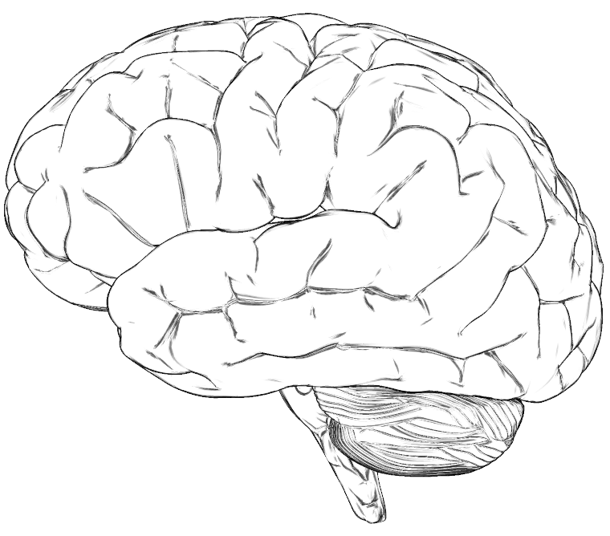
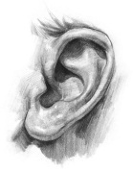
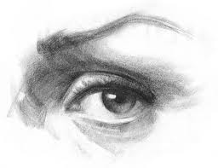
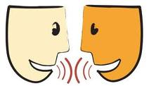
The Human Brain – a bit like a computer …

Slide 3
What’s going on inside the computer?
IMAGINATION
MEMORY
EMOTION

Slide 4
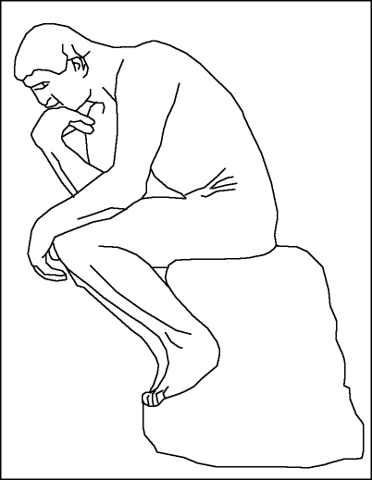
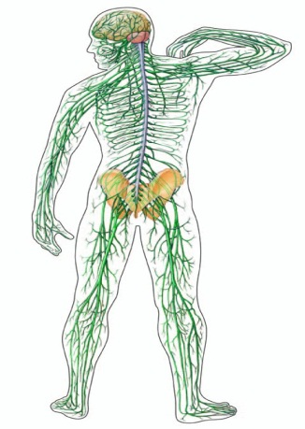
What’s going on inside the computer?
LOGIC
ANALYZING
PLANNING
PROBLEM-SOLVING
IMAGINATION
MEMORY
EMOTION
SENSATIONS

Slide 5
What’s going on inside the computer?
LOGIC
ANALYZING
PLANNING
PROBLEM-SOLVING
IMAGINATION
AWARENESS
MEMORY
EMOTION
SENSATIONS

Slide 6
The Attention Centre – the Central Processing Unit
LOGIC
ANALYZING
PLANNING
PROBLEM-SOLVING
IMAGINATION
AWARENESS
MEMORY
EMOTION
SENSATIONS

Slide 7
The Attention Centre – the Central Processing Unit
Neuroplasticity – ‘mind-gym’
LOGIC
ANALYZING
PLANNING
PROBLEM-SOLVING
IMAGINATION
AWARENESS
MEMORY
EMOTION
SENSATIONS

Slide 8
Neuroplasticity – ‘mind-gym’
LOGIC
ANALYZING
PLANNING
PROBLEM-SOLVING
IMAGINATION
AWARENESS
MEMORY
EMOTION
SENSATIONS

Slide 9
What happens to our brains at school?
LOGIC
ANALYZING
PLANNING
PROBLEM-SOLVING
IMAGINATION
AWARENESS
MEMORY
EMOTION
SENSATIONS

Slide 10
Lots of training in thinking …
LOGIC
ANALYZING
PLANNING
PROBLEM-SOLVING
IMAGINATION
AWARENESS
MEMORY
EMOTION
SENSATIONS

Slide 11
Minimal training in attention or emotional regulation …
LOGIC
ANALYZING
PLANNING
PROBLEM-SOLVING
IMAGINATION
AWARENESS
MEMORY
EMOTION
SENSATIONS

Slide 12
‘Brain loops’ or ‘Short Circuits’
LOGIC
ANALYZING
PLANNING
PROBLEM-SOLVING
IMAGINATION
AWARENESS
MEMORY
EMOTION
SENSATIONS

Slide 13
An ‘anxiety loop’ …
LOGIC
ANALYZING
PLANNING
PROBLEM-SOLVING
IMAGINATION
AWARENESS
MEMORY
EMOTION
SENSATIONS

Slide 14
An ‘anxiety loop’ …
LOGIC
ANALYZING
PLANNING
PROBLEM-SOLVING
IMAGINATION
AWARENESS
MEMORY
EMOTION
SENSATIONS

Slide 15
An ‘depression loop’ …
LOGIC
ANALYZING
PLANNING
PROBLEM-SOLVING
IMAGINATION
AWARENESS
MEMORY
EMOTION
SENSATIONS

Slide 16
The Good News …
LOGIC
ANALYZING
PLANNING
PROBLEM-SOLVING
IMAGINATION
AWARENESS
MEMORY
EMOTION
SENSATIONS
After Mindfulness Training

Slide 17
Enables us to escape from brain loops…
LOGIC
ANALYZING
PLANNING
PROBLEM-SOLVING
IMAGINATION
AWARENESS
MEMORY
EMOTION
SENSATIONS
After Mindfulness Training

Slide 18
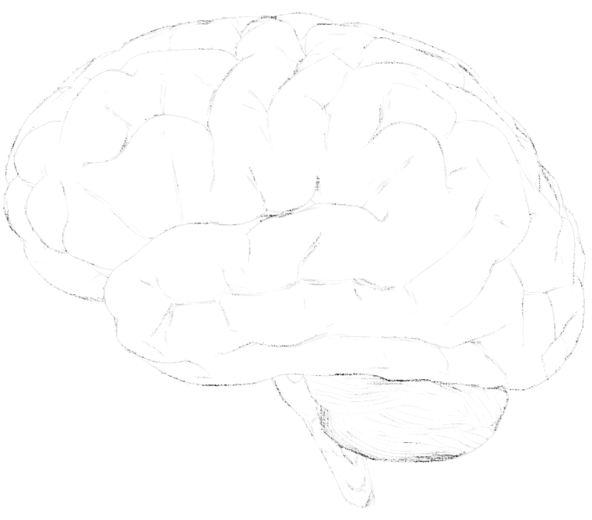
A Wheel of Awareness …
THOUGHT
IMAGINATION
HUB OF AWARENESS
(Attention)
MEMORY
EMOTION
SENSATIONS
Ref – The Whole Brain Child, Siegel & Bryson

Slide 19
A Wheel of Awareness …
THOUGHT
IMAGINATION
HUB OF AWARENESS
(Attention)
MEMORY
EMOTION
SENSATIONS
Ref – The Whole Brain Child, Siegel & Bryson

Slide 20
How I use it at work …
The powerpoint animation lives on my notepad computer and I show it to clients when appropriate.
The Wheel of Awareness diagram is laminated and lives on my (physical) desk top.
These tools will be on the ACBS website should you wish to access and use them.

